Slide 1

Multi-Language Text Extraction Using Image
Final Year Project Phase-II
Batch 2020-2024
Presented By
Yuvraj Kumar - 2020105262
Zayiechutuo Lohe - 2020105263
Under the Supervision of
Dr. Shouvik Dey
National Institute of Technology Nagaland
Department of Computer Science & Engineering
Chumukedima, Nagaland-797103

Slide 2
CONTENTS
Introduction
Objective
Flowchart
Work Completed
Implementation Details
Result
Future Vision
Conclusion
Reference
1

Slide 3
INTRODUCTION
In this time of the world even though most of the information is digitalized, many are still in the form of paper, photographs, signs, etc.
There is a need for systems that can extract against general background.
This can help in translation of books, reading signs of a different language and many more other applications.
2

Slide 4
OBJECTIVE
• To extract the text from the images.
• To identify the language of a piece of text accurately.
• Translate the multilanguages into english language.
3

Slide 5
FLOWCHART
Input Image
Extract Text from Image
Identify Language
Translate to English
Output Text
4

Slide 6
WORK COMPLETED
This project is a three phase project which includes Text extraction from image, Language Identification from the extracted texts and translation of the identified text to English if the given text is not in English.
Text extraction is done using Pytesseract after the preprocessing process is completed.
Language Identification is done using dataset from kaggle.com trained against various training models.
5

Slide 7

TECHNOLOGIES USED
Jupyter Notebook
Python 3
Open CV, PyTesseract, Sklearn
Matplotlib, Numpy, Pandas
Language dataset includes
17 Languages
Kaggle.com
Language
Dataset
Logistic
Regression
6

Slide 8
EXTRACTION OF TEXT FROM IMAGE
image
preprosessing
(Noise
Reduction)
OCR
using
Pytesseract
(image to text)
load Image
(OpenCV)
Input image
Extracted Text
Workflow diagram of Text extraction from image
7

Slide 9
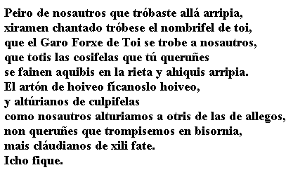
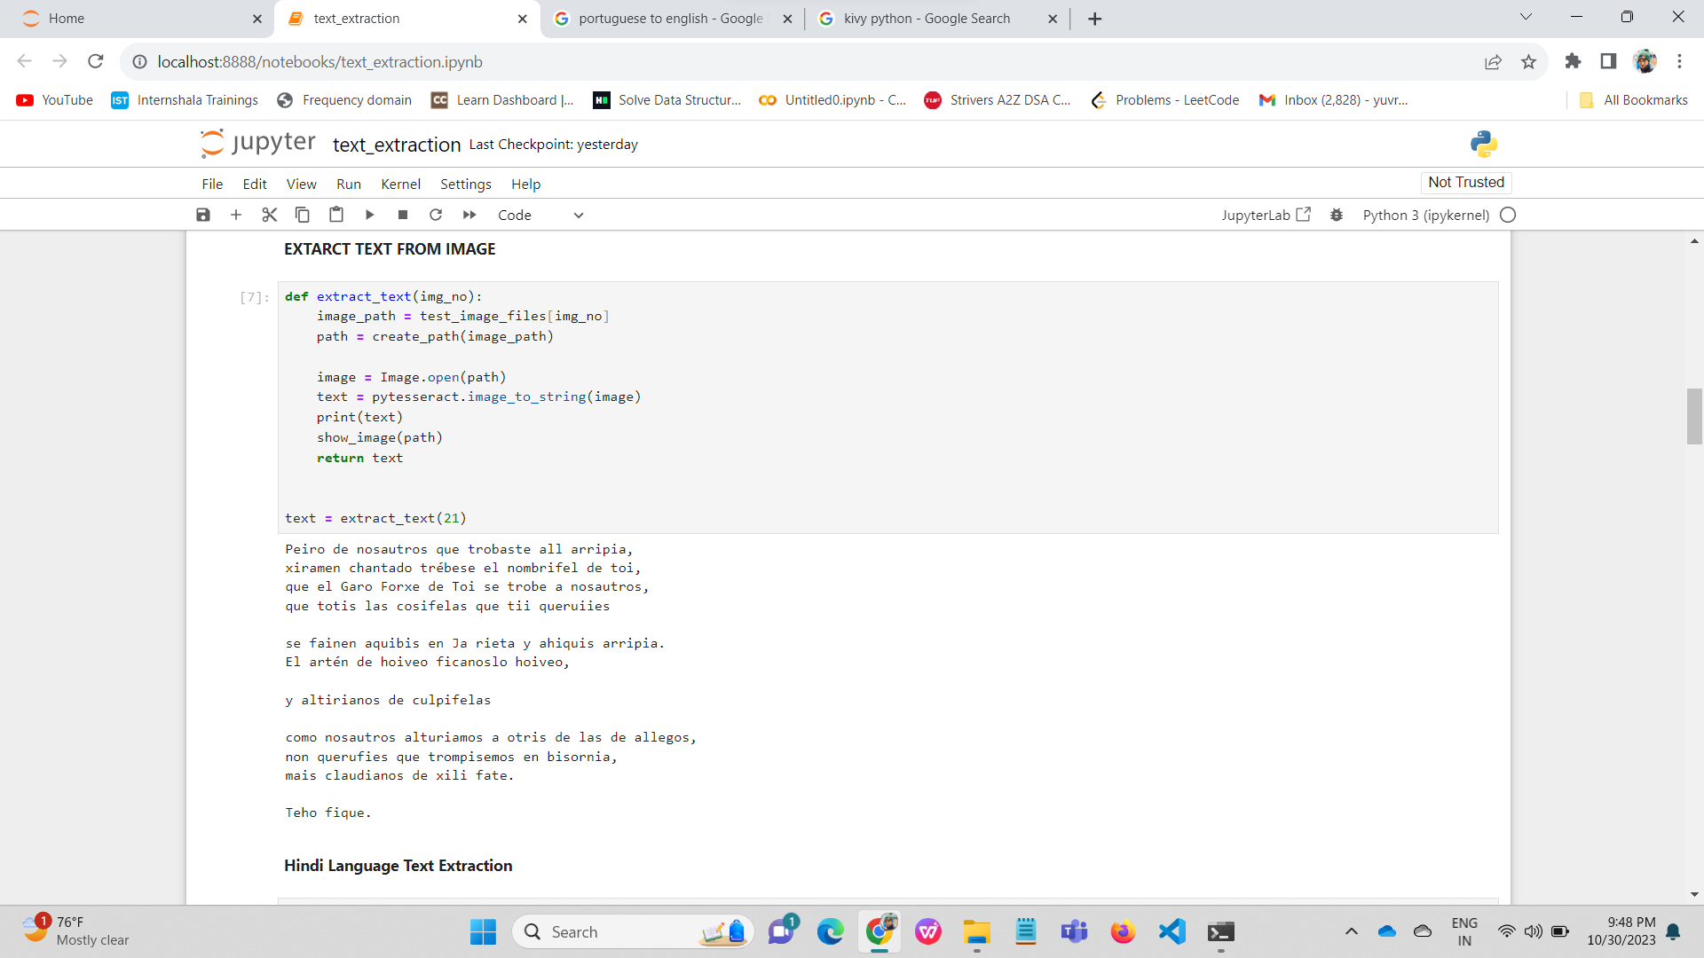
EXTRACTION OF TEXT FROM IMAGE
Image
Extracted Text
8

Slide 10
LANGUAGE IDENTIFICATION
Datasets
(English,
Hindi,
Spanish and more
Data
Preprocessing
(Remove
Punctuations)
d
Pipelining)
Tfidfverification
INPUT TEXT
Logistic Regression
Testing
Workflow diagram of Language Identification
9

Slide 11
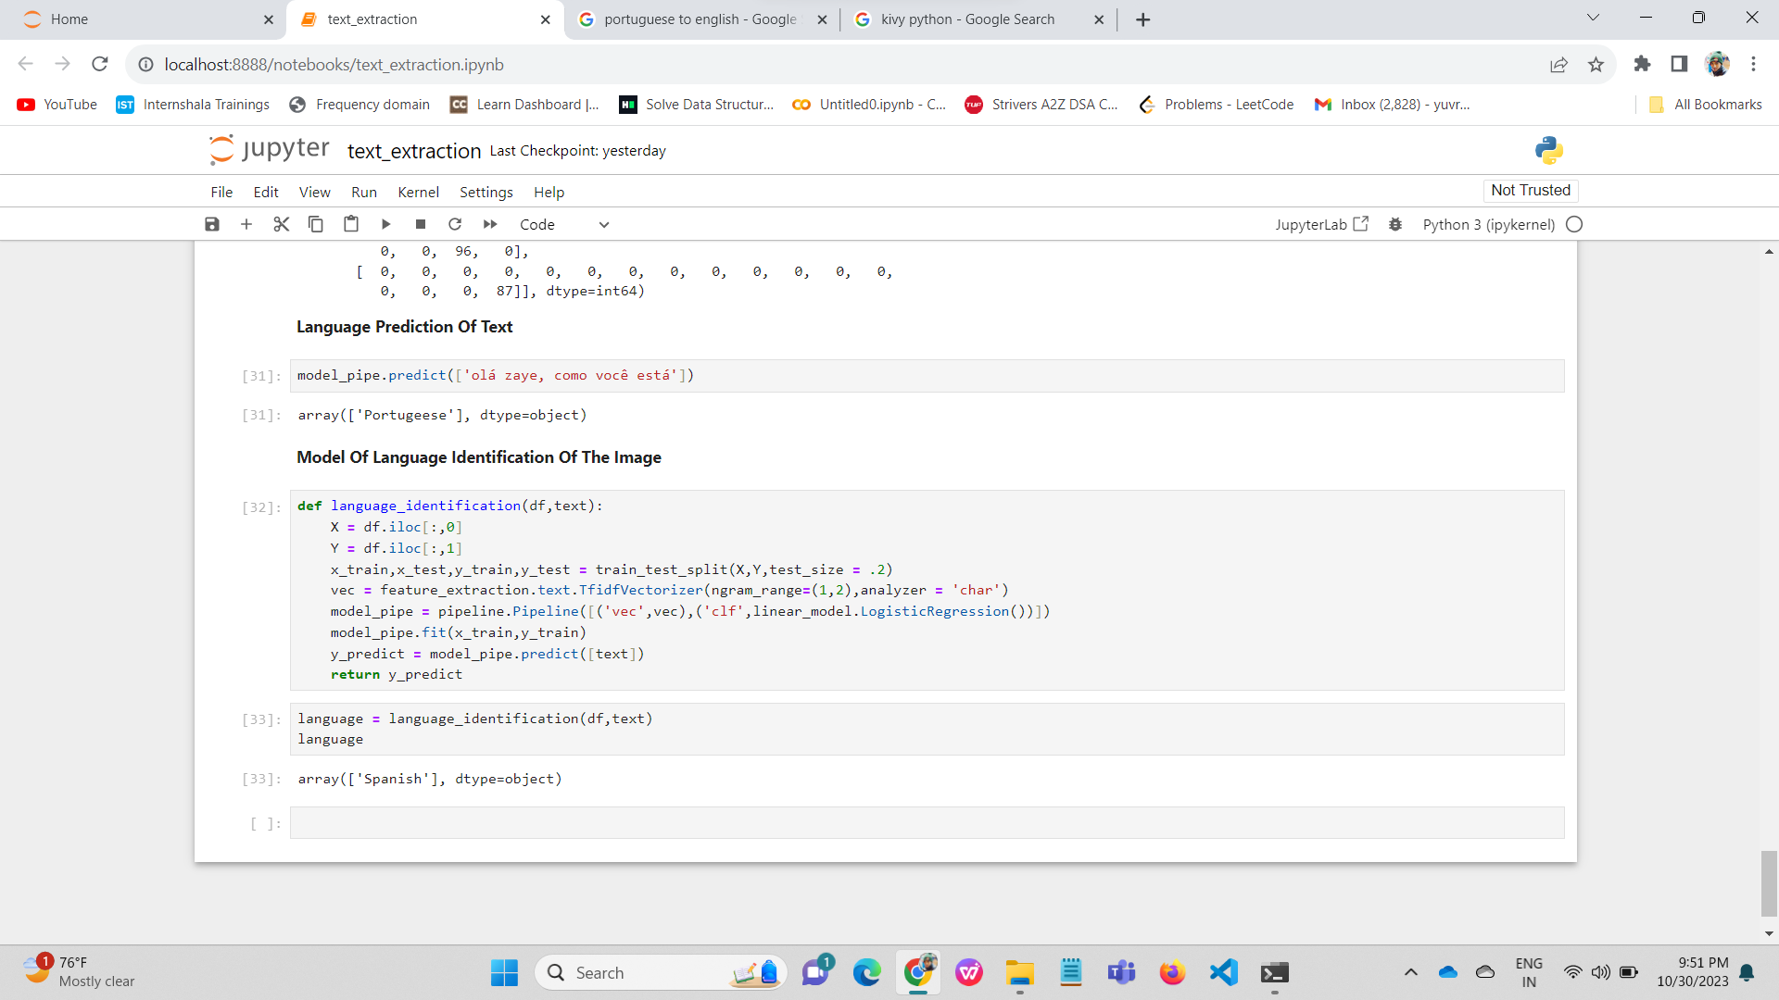
LANGUAGE IDENTIFICATION
Extracted Text
Language Identified
10

Slide 12
RESULT
SL No. | Method | Accuracy
1 | Logistic Regression | 98.45%
11

Slide 13
FUTURE VISION
Accuracy test using more Models like Naive Bayes and SVM
Accuracy test of degraded images
Translation of the extracted texts
Design User Interface for smooth function of the project
12

Slide 14
CONCLUSION
The extraction of texts of image for some few major languages have been successful.
The identification of the texts have also been tested and is showing a high accuracy of success.
The exact accuracy will be available when the dataset is trained against more models and images of lower quality.
13

Slide 15
REFERENCES
[1] Mittal, R., & Garg, A. . Text extraction using OCR: A Systematic Review. 2020 Second International Conference on Inventive Research in Computing Applications (ICIRCA), 2020.
[2] Ahmed, Bashir, Sung-Hyuk Cha, and Charles Tappert. "Language identification from text using n-gram based cumulative frequency addition." Proceedings of Student/Faculty Research Day, CSIS, Pace University 12, no. 1, 2004.
14

Slide 16
REFERENCES
[3] Verma, Vicky Kumar, and Nitin Khanna. "Indian language identification using k-means clustering and support vector machine (SVM)." In 2013 Students Conference on Engineering and Systems (SCES), pp. 1-5. IEEE, 2013.
[4] Tom Kocmi and Ondřej Bojar. LanideNN: Multilingual Language Identification on Character Window. In Proceedings of the 15th Conference of the European Chapter of the Association for Computational Linguistics: Volume 1, Long Papers, pages 927–936, Valencia, Spain. Association for Computational Linguistics,2017.
15

Slide 17
THANK YOU

